Slide 2
Respectful Language Pertaining to Disabilities

Slide 3
Respectful Language Pertaining to Disabilities
Joe Solseng
Schroeter Goldmark & Bender
solseng@sgb-law.com | sgb-law.com

Slide 4
1 in 4, or 61 million, U.S. adults reports having some form of disability

Slide 5
WORDS MATTER

Slide 6
A DISABILITY IS NOT AN ILLNESS
PEOPLE WITH DISABILITIES ARE NOT PATIENTS

Slide 7
IT AIN’T UP TO YOU

Slide 9
Emphasize abilities, not limitations
USE | DO NOT USE

Slide 10
Emphasize abilities, not limitations
USE | DO NOT USE
PERSON WHO USES A WHEELCHAIR

Slide 11
Emphasize abilities, not limitations
USE | DO NOT USE
PERSON WHO USES A WHEELCHAIR | WHEELCHAIR-BOUND; CONFINED TO A WHEELCHAIR

Slide 12
Emphasize abilities, not limitations
USE | DO NOT USE
PERSON WHO USES A WHEELCHAIR | WHEELCHAIR-BOUND; CONFINED TO A WHEELCHAIR
PERSON WHO USES A COMMUNICATION DEVICE; USES AN ALTERNATIVE METHOD OF COMMUNICATION

Slide 13
Emphasize abilities, not limitations
USE | DO NOT USE
PERSON WHO USES A WHEELCHAIR | WHEELCHAIR-BOUND; CONFINED TO A WHEELCHAIR
PERSON WHO USES A COMMUNICATION DEVICE; USES AN ALTERNATIVE METHOD OF COMMUNICATION | IS NON-VERAL; CANNOT TALK

Slide 14
PEOPLE WITH DISABILITIES ARE INDIVIDUALS
DISABLED PEOPLE ARE INDIVIDUALS

Slide 17
PERSON-FIRST Language
USE | DO NOT USE

Slide 18
PERSON-FIRST Language
USE | DO NOT USE
PERSON WITH A DISABILITY

Slide 19
PERSON-FIRST Language
USE | DO NOT USE
PERSON WITH A DISABILITY | DISABLED PERSON; THE DISABLED

Slide 20
PERSON-FIRST Language
USE | DO NOT USE
PERSON WITH A DISABILITY | DISABLED PERSON; THE DISABLED
MAN WITH PARAPLEGIA

Slide 21
PERSON-FIRST Language
USE | DO NOT USE
PERSON WITH A DISABILITY | DISABLED PERSON; THE DISABLED
MAN WITH PARAPLEGIA | PARAPLEGIC; PARAPLEGIC MAN

Slide 22
PERSON-FIRST Language
USE | DO NOT USE
PERSON WITH A DISABILITY | DISABLED PERSON; THE DISABLED
MAN WITH PARAPLEGIA | PARAPLEGIC; PARAPLEGIC MAN
PERSON WITH A LEARNING DISABILITY

Slide 23
PERSON-FIRST Language
USE | DO NOT USE
PERSON WITH A DISABILITY | DISABLED PERSON; THE DISABLED
MAN WITH PARAPLEGIA | PARAPLEGIC; PARAPLEGIC MAN
PERSON WITH A LEARNING DISABILITY | SLOW LEARNER

Slide 24
PERSON-FIRST Language
USE | DO NOT USE
PERSON WITH A DISABILITY | DISABLED PERSON; THE DISABLED
MAN WITH PARAPLEGIA | PARAPLEGIC; PARAPLEGIC MAN
PERSON WITH A LEARNING DISABILITY | SLOW LEARNER
STUDENT RECEIVING SPECIAL EDUCATION SERVICES

Slide 25
PERSON-FIRST Language
USE | DO NOT USE
PERSON WITH A DISABILITY | DISABLED PERSON; THE DISABLED
MAN WITH PARAPLEGIA | PARAPLEGIC; PARAPLEGIC MAN
PERSON WITH A LEARNING DISABILITY | SLOW LEARNER
STUDENT RECEIVING SPECIAL EDUCATION SERVICES | SPECIAL EDUCATION STUDENT

Slide 26
PERSON-FIRST Language
USE | DO NOT USE
PERSON WITH A DISABILITY | DISABLED PERSON; THE DISABLED
MAN WITH PARAPLEGIA | PARAPLEGIC; PARAPLEGIC MAN
PERSON WITH A LEARNING DISABILITY | SLOW LEARNER
STUDENT RECEIVING SPECIAL EDUCATION SERVICES | SPECIAL EDUCATION STUDENT
PERSON OF SHORT STATURE OR LITTLE PERSON

Slide 27
PERSON-FIRST Language
USE | DO NOT USE
PERSON WITH A DISABILITY | DISABLED PERSON; THE DISABLED
MAN WITH PARAPLEGIA | PARAPLEGIC; PARAPLEGIC MAN
PERSON WITH A LEARNING DISABILITY | SLOW LEARNER
STUDENT RECEIVING SPECIAL EDUCATION SERVICES | SPECIAL EDUCATION STUDENT
PERSON OF SHORT STATURE OR LITTLE PERSON | DWARF; MIDGET

Slide 28
IDENTITY-FIRST LANGUAGE
USE | DO NOT USE

Slide 29
IDENTITY-FIRST LANGUAGE
USE | DO NOT USE
DEAF PERSON

Slide 30
IDENTITY-FIRST LANGUAGE
USE | DO NOT USE
DEAF PERSON | PERSON WHO IS DEAF

Slide 31
IDENTITY-FIRST LANGUAGE
USE | DO NOT USE
DEAF PERSON | PERSON WHO IS DEAF
AUTISTIC PERSON

Slide 32
IDENTITY-FIRST LANGUAGE
USE | DO NOT USE
DEAF PERSON | PERSON WHO IS DEAF
AUTISTIC PERSON | PERSON WITH AUTISM

Slide 33
WHEN IN DOUBT GO WITH PERSON-FIRST

Slide 34
USE NEUTRAL LANGUAGE
USE | DO NOT USE

Slide 35
USE NEUTRAL LANGUAGE
USE | DO NOT USE
PERSON WHO HAS HAD A STOKE

Slide 36
USE NEUTRAL LANGUAGE
USE | DO NOT USE
PERSON WHO HAS HAD A STOKE | STROKE VICTIM

Slide 37
USE NEUTRAL LANGUAGE
USE | DO NOT USE
PERSON WHO HAS HAD A STOKE | STROKE VICTIM
CONGENTAL DISABILITY

Slide 38
USE NEUTRAL LANGUAGE
USE | DO NOT USE
PERSON WHO HAS HAD A STOKE | STROKE VICTIM
CONGENTAL DISABILITY | BIRTH DEFECT

Slide 39
USE NEUTRAL LANGUAGE
USE | DO NOT USE
PERSON WHO HAS HAD A STOKE | STROKE VICTIM
CONGENTAL DISABILITY | BIRTH DEFECT
PERSON WITH EPILEPSY

Slide 40
USE NEUTRAL LANGUAGE
USE | DO NOT USE
PERSON WHO HAS HAD A STOKE | STROKE VICTIM
CONGENTAL DISABILITY | BIRTH DEFECT
PERSON WITH EPILEPSY | PERSON AFFLICTED WITH EPILEPSY; EPILEPTIC

Slide 41
USE NEUTRAL LANGUAGE
USE | DO NOT USE
PERSON WHO HAS HAD A STOKE | STROKE VICTIM
CONGENTAL DISABILITY | BIRTH DEFECT
PERSON WITH EPILEPSY | PERSON AFFLICTED WITH EPILEPSY; EPILEPTIC
PERSON WITH A BRAIN INJURY

Slide 42
USE NEUTRAL LANGUAGE
USE | DO NOT USE
PERSON WHO HAS HAD A STOKE | STROKE VICTIM
CONGENTAL DISABILITY | BIRTH DEFECT
PERSON WITH EPILEPSY | PERSON AFFLICTED WITH EPILEPSY; EPILEPTIC
PERSON WITH A BRAIN INJURY | BRAIN DAMAGED; BRAIN INJURY SUFFERER

Slide 43
USE NEUTRAL LANGUAGE
USE | DO NOT USE
PERSON WHO HAS HAD A STOKE | STROKE VICTIM
CONGENTAL DISABILITY | BIRTH DEFECT
PERSON WITH EPILEPSY | PERSON AFFLICTED WITH EPILEPSY; EPILEPTIC
PERSON WITH A BRAIN INJURY | BRAIN DAMAGED; BRAIN INJURY SUFFERER
BURN SURVIVOR

Slide 44
USE NEUTRAL LANGUAGE
USE | DO NOT USE
PERSON WHO HAS HAD A STOKE | STROKE VICTIM
CONGENTAL DISABILITY | BIRTH DEFECT
PERSON WITH EPILEPSY | PERSON AFFLICTED WITH EPILEPSY; EPILEPTIC
PERSON WITH A BRAIN INJURY | BRAIN DAMAGED; BRAIN INJURY SUFFERER
BURN SURVIVOR | BURN VICTIM

Slide 45
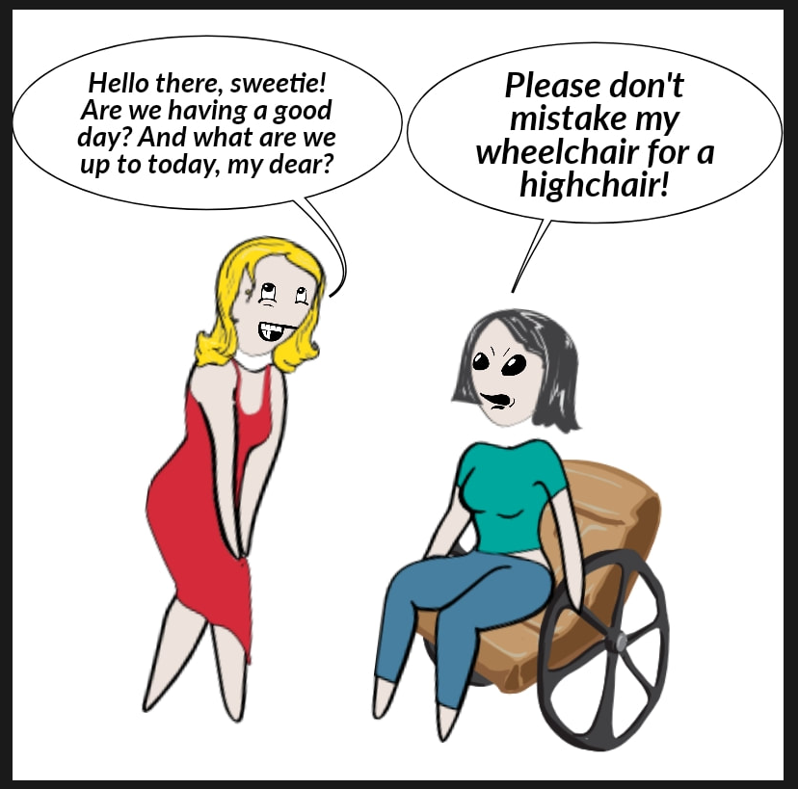

Slide 46
DO NOT USE CONDESCENDING EUPHMISMIS
“DIFFERENTLY-ABLED”
“CHALLENGED”
“HANDI-CAPABLE”
“SPECIAL”

Slide 47
DO NOT USE OFFENSIVE LANGUAGE

Slide 49
BE KIND
BE THOUGHTFUL

Slide 50
Respectful Language Pertaining to Disabilities
Joe Solseng
Schroeter Goldmark & Bender
solseng@sgb-law.com | sgb-law.com

