Slide 1
ADDING CASE PARTICIPANTS – 2

Slide 2
BEFORE YOU BEGIN, REMEMBER. . .
You must enter all attorneys associated with this case. Because you are logged into ECF as the attorney filing this case, you do not need to enter your name as attorney of record.
ONLY add those attorneys who have properly signed the Complaint or Notice of Removal in addition to any attorneys who have appeared on behalf of the Plaintiff(s) in State court when filing a removal case.
NEVER ENTER PRO HAC VICE ATTORNEYS.

DO NOT USE THE BROWSER BACK BUTTON AT ANY TIME during this process. You will lose your entire work product. If you need to make changes or corrections to your party, see Icons in the Participant Tree for instructions.

Slide 3
ADDING AN ATTORNEY
To add an attorney to a party, click the icon next to ATTORNEY.
Enter the attorney’s bar number or name in the SEARCH FOR AN ATTORNEY screen and click SEARCH.
Only attorneys in the ECF database are provided in the search results.
Once you have found the correct attorney, click SELECT ATTORNEY to display the ATTORNEY INFORMATION screen.

Slide 4
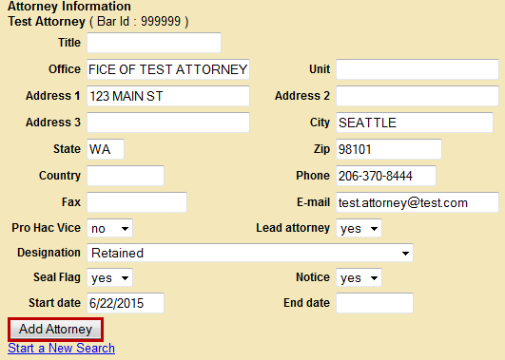
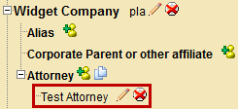
ATTORNEY INFORMATION SCREEN

DO NOT ALTER ANY INFORMATION ON THIS SCREEN.
Click ADD ATTORNEY to add him/her to the case.
Notice the attorney’s name has been added to the Participant Tree under the party you selected.
Repeat this process until attorneys are entered.

Slide 5
ADDING AN ALIAS
If your Complaint caption indicates an alias, select the icon next to ALIAS for the appropriate party in the Participant Tree.
Enter the alias name in the SEARCH FOR AN ALIAS screen and click SEARCH.
If a match is found, highlight the name and click SELECT ALIAS; otherwise, click CREATE NEW ALIAS.

Slide 6
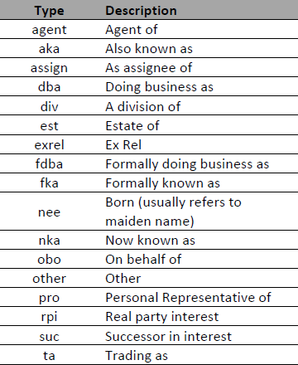
ALIAS INFORMATION SCREEN
In the ALIAS INFORMATION screen, enter the alias and select a TYPE from the dropdown menu.
Once you have finished entering your alias information, click ADD ALIAS.
Notice the alias has been added to the Participant Tree under the party you selected.
Repeat this process until all aliases are entered.

Slide 7
ADDING A CORPORATE PARENT/OTHER AFFILIATE

DO NOT ADD A CORPORATE PARENT during case opening. You are required to add corporate parents/other affiliates when filing a CORPORATE DISCLOSURE STATEMENT.

Slide 8
CREATING YOUR CIVIL CASE

Before creating your case, be sure that all parties have been added and their information entered correctly.
When you are certain your case information is accurate and complete, click CREATE CASE at the top of the Participant Tree.
The following pop-up message will be displayed.
Click YES to proceed with filing the case.

Slide 9
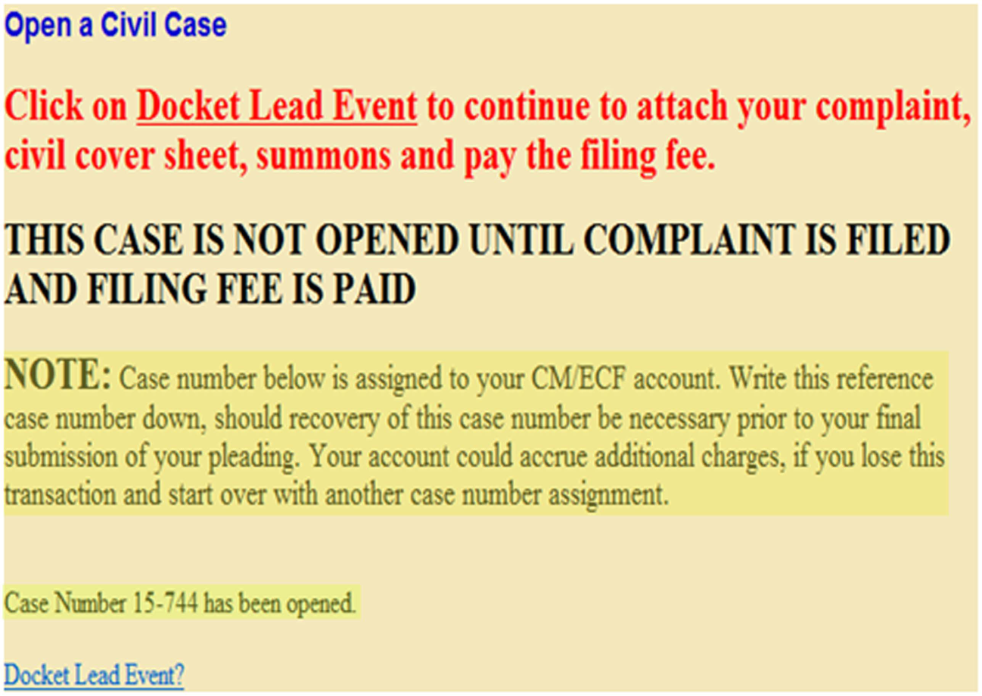
CREATING YOUR CIVIL CASE
You will notice ECF has now assigned a case number.
NOTE
Although the case is created, it will NOT be opened until the initiating document is filed and the filing fee is paid (if required).

